Slide 1
Product sale analysis using Data Analytics
Presented by: K.Nithish
Reg no: 912421104025

Slide 2
Phase 3: Development part 1

Slide 3

Introduction
Sales data is a term that includes a large array of metrics but, broadly speaking, if you can measure something in relation to the sales process, it’s viable sales data. Modern software like Cloud CRM solutions can help you collect this data, but it’s important to learn how to read this data to understand what it means for your business and where you can improve.https://www.pipedrive.com/en/blog/sales-data

Slide 4

Objective
Assessment and improvement of the quality of the data.
Compare the target population with the population being studied (sampling population).
Forecast the possible areas where faults can occur (such as degree of non-response, amount of denials, the comparison groups or the reduction or decrease in number).
Assessment of the measures of frequency (such as mean, median, mode, etc.) and their amount.

Slide 5

Data analysis
Data analysis is a process for obtaining raw data, and subsequently converting it into information useful for decision-making by users.
Data is collected and analyzed to answer questions, test hypotheses, or disprove theories.

Slide 6

Abstract
Product analytics is the process of analyzing how users engage with a product or service. It enables product teams to track, visualize, and analyze user engagement and behavior data. Teams use this data to improve and optimize a product or service.​
Data abstraction allows consumers to use a product without knowing how it works internally. It has several benefits for product development, including making a more convenient user experience and safeguarding the product’s uniqueness.​

Slide 7
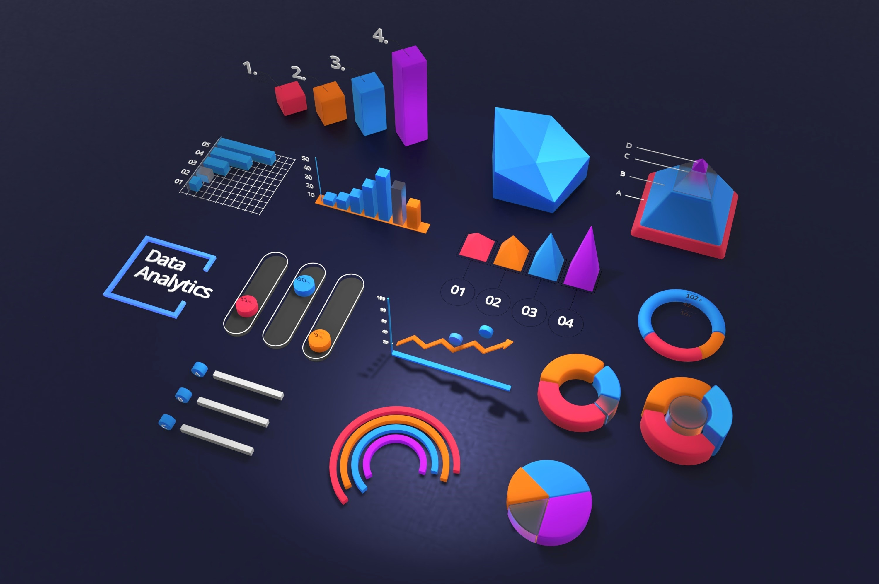
Market Segmentation
Market segmentation data analysis is a method of breaking your customers or potential market down into actionable categories- into groups that you can treat differently from one another in an effort to reach them more effectively.
Market segmentation is a process companies use to break their potential customers into different sections. This allows the company to allocate the appropriate resource to each individual segment which allows for more accurate targeting across a variety of marketing campaigns.

Slide 8
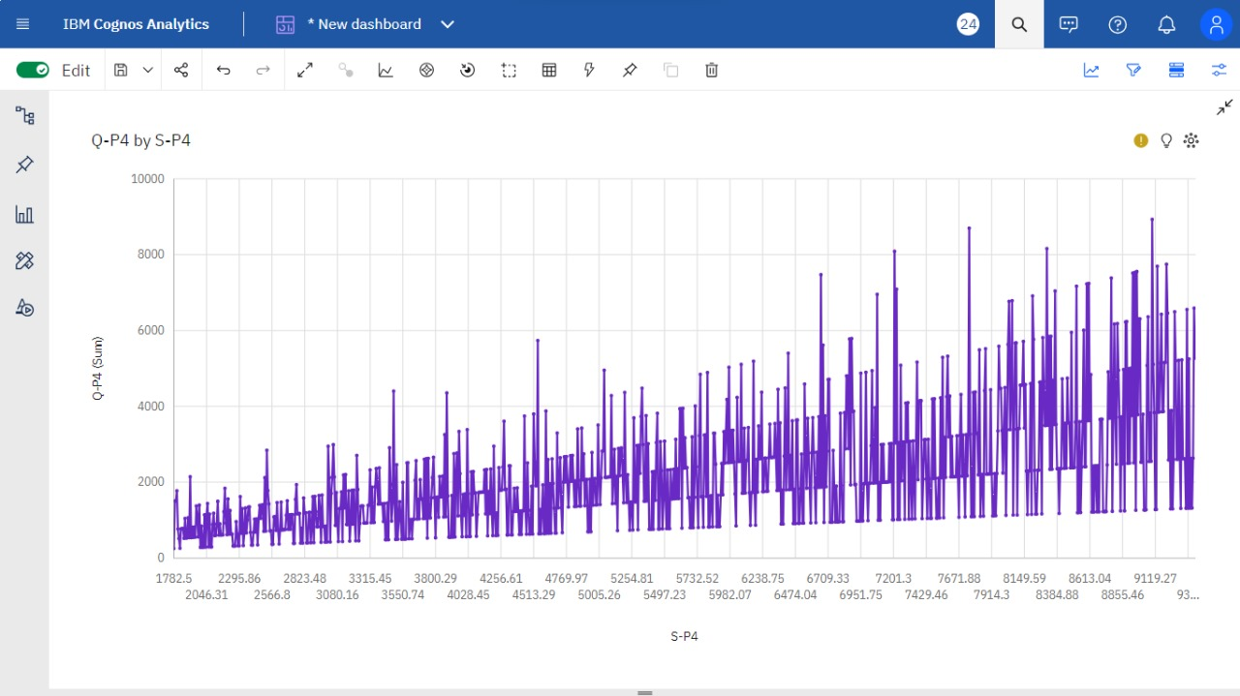
Product sale analysis (Q-P4 by S-P4)

Slide 9

Sales data analysis
Data analysis is the process of inspecting, cleansing, transforming, and modeling data with the goal of discovering useful information, informing conclusions, and supporting decision-making.
Data analysis has multiple facets and approaches, encompassing diverse techniques under a variety of names, and is used in different business, science, and social science domains.

Slide 10
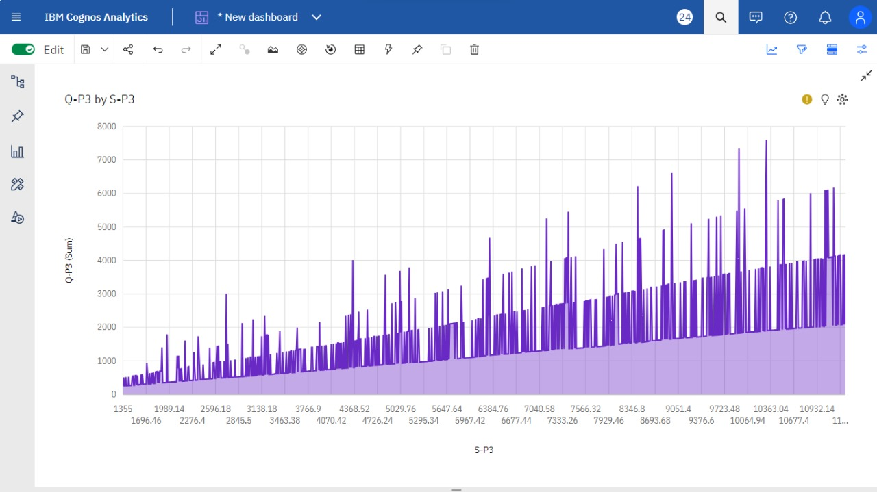
PRODUCT SALE ANALYSIS (Q-P3 by s-p3)

Slide 11
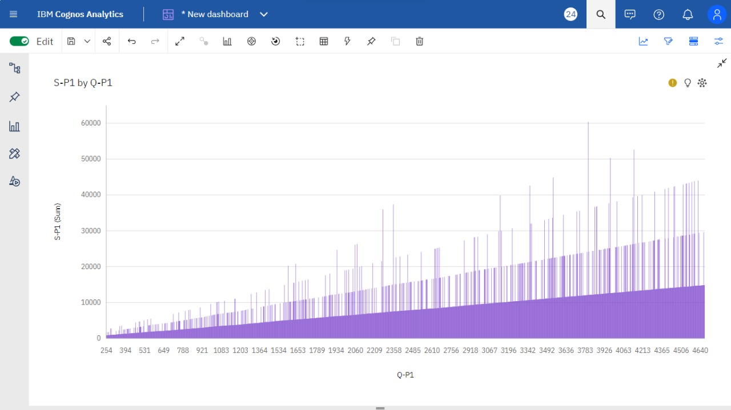
Product sale analysis (s-p1 by q-p1

Slide 12

Diagnostic Analysis
Diagnostic analytics allows you to analyze why people are not converting or purchasing by looking at which steps they were at when they dropped off, and inferring why.​
It is common for the number of users to decrease at each stage of the marketing funnel.​

Slide 13
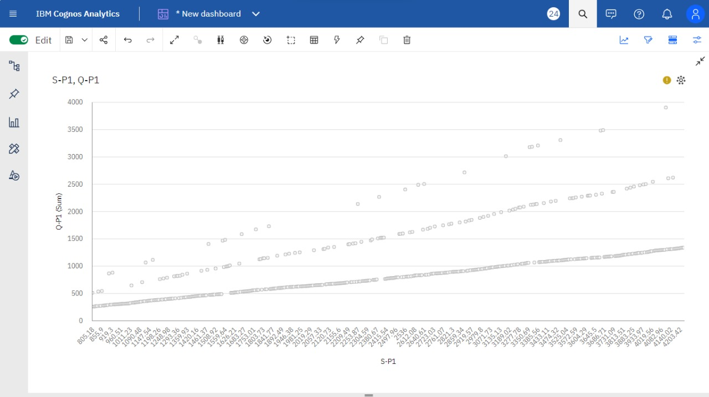
Product sale analysis (s-p1,q-p1)

Slide 14
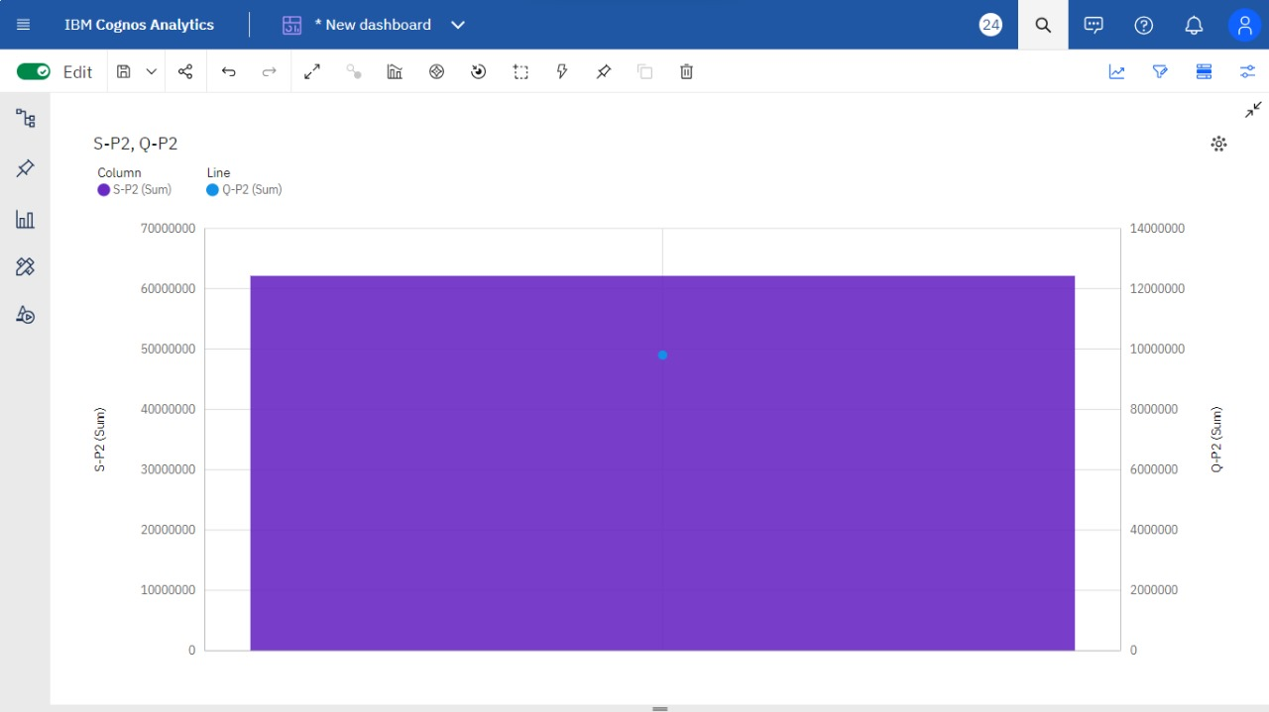
Product sale analysis (s-p2,q-p2)

Slide 15

Data Collection
Data collection or data gathering is the process of gathering and measuring information on targeted variables in an established system, which then enables one to answer relevant questions and evaluate outcomes.
Data collection is a research component in all study fields, including physical and social sciences, humanities, and business.
The goal for all data collection is to capture evidence that allows data analysis to lead to the formulation of credible answers to the questions that have been posed.

Slide 16

Sales management
Sales management is a business discipline which is focused on the practical application of sales techniques and the management of a firm’s sales operations. ​
It is an important business function as net sales, through the sale of products and services and resulting profit, drive most commercial business. These are also typically the goals and performance indicators of sales management.​ Sales manager is the typical title of someone whose role is sales management. The role typically involves talent development.​

Slide 17
Conclusion
Product data analytics is an essential aspect of the product management process. It enables teams to analyze user behavior and product performance and make informed decisions to improve the product and customer experience.​

